Slide 1
Geological and Geophysical Assessment of Forties Field in North Sea
GPGN 558 Seismic Data Interpretation Project 2
Group 3:
Nadima Dwihusna
Rosie Zhu
Kyle Fry

Slide 2
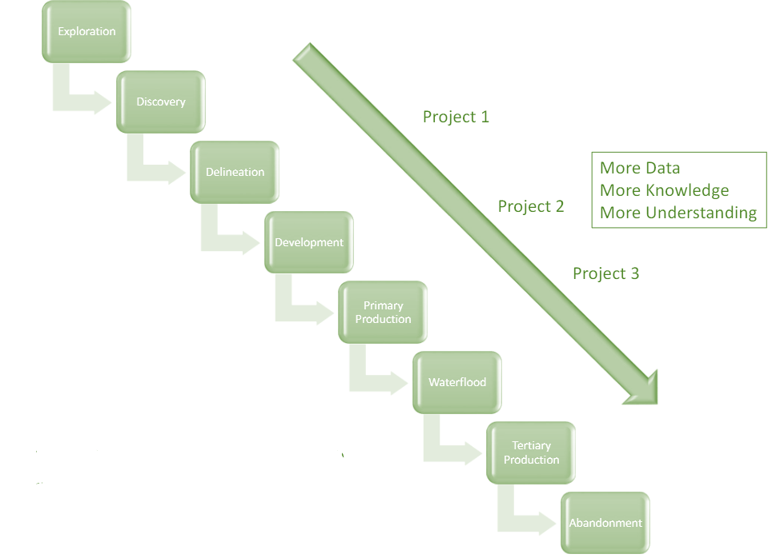
Notes:
We want to focus on the red box
How we interpret seismic data

Slide 3
Exploration Workflow
Geological
Framework
Volume
Attribute Maps
Prospect
Elements
Prospect Assessment
Tectonic History
Structural Interpretation
- Faults and folds
- Uplifts
- Structural trends/features
Stratigraphic Interpretation
- Unconformities
- Packages
- Facies, lithologies, ages
Present Day Conditions
Analyze Key Packages
- Potential Reservoirs
- Source Rocks
Source
Reservoir
Migration
Trap
Chance of Success
- Trap size
- Hydrocarbon Content
- Compartments
- Recovery factor
Notes:
Develop geologic framework
Major faults, unconformities and stratigraphic packages (depositional sequences)
Structural interpretations
Faults folds
Uplifts
Structural trends and features
Stratigraphic interpretation
Unconformities
Packages
Facies, lithologies, ages
Basin reconstruction - how things evolved
Data analysis
Analyze all the key packages -- where are potential reservoirs, source rocks, etc
Present day conditions - how things are now
Prospect elements (Source, Migration, Reservoir, Trap)
Identify prospects -- where all the HC system elements look favorable
Where we are willing to propose a drill site to management
Prospect assessments
What type of volume of HC do we expect?
What is the chance of success or risk?

Slide 4
Exploration Workflow
Geological
Framework
Volume
Attribute Maps
Prospect
Elements
Prospect Assessment
Tectonic History
Structural Interpretation
- Faults and folds
- Uplifts
- Structural trends/features
Stratigraphic Interpretation
- Unconformities
- Packages
- Facies, lithologies, ages
Present Day Conditions
Analyze Key Packages
- Potential Reservoirs
- Source Rocks
Source
Reservoir
Migration
Trap
Chance of Success
- Trap size
- Hydrocarbon Content
- Compartments
- Recovery factor
Notes:
Develop geologic framework
Major faults, unconformities and stratigraphic packages (depositional sequences)
Structural interpretations
Faults folds
Uplifts
Structural trends and features
Stratigraphic interpretation
Unconformities
Packages
Facies, lithologies, ages
Basin reconstruction - how things evolved
Data analysis
Analyze all the key packages -- where are potential reservoirs, source rocks, etc
Present day conditions - how things are now
Prospect elements (Source, Migration, Reservoir, Trap)
Identify prospects -- where all the HC system elements look favorable
Where we are willing to propose a drill site to management
Prospect assessments
What type of volume of HC do we expect?
What is the chance of success or risk?

Slide 5
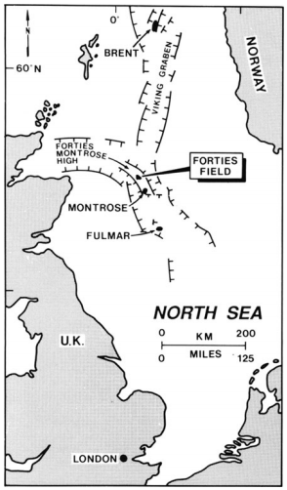
Survey Location
Forties field is located in North Sea approximately 180 km east-northeast of Aberdeen and lies in the United Kingdom License Block 21/10.
The estimated Ultimate Recovery is 1.76 BSTB with an estimated of 3.9 BSTB of OOIP
Discovered by British Petroleum (BP)
Notes:
The Forties field is located in the North Sea approximately 180 km east-northeast of Aberdeen and lies in the UK License Block 21/10 and discovered by British Petroleum BP in the Paleocene sandstones of the Forties Formation.
There are faults both east and west of the forties field. There is a high forties montrose through the forties field. The sediments migrates from the north west to the south east as seen in the next slide

Slide 6
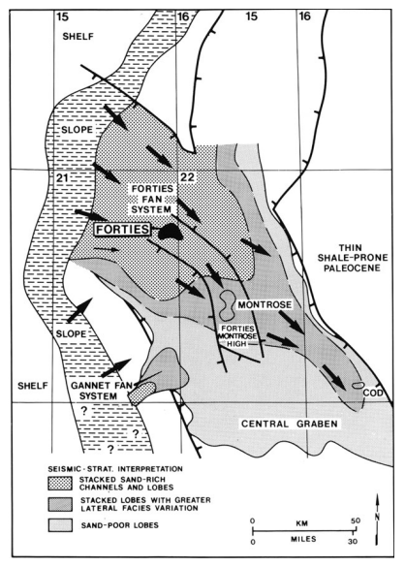
Survey Location
Petroleum accumulations occurred in thick sandstone of Late Paleocene deposited through a series of sand-rich submarine fans sequence from the northwest (arrows).
Generation-Migration-Accumulation:
Middle Miocene to the Holocene
Notes:
This is the reconstruction of the upper Paleocene paleogeography of the Central Graben of the U.K. North Sea based on regional seismic interpretation
The sandstone reservoir of the Forties Field forms part of a major submarine-fan body which covered the Central Graben area of the North Sea basin during the Paleocene as seen in the image.
The sediment source for the Forties submarine fan moves from the north west as seen by the arrows in the image
https://sp.lyellcollection.org/content/403/1/333/tab-figures-data

Slide 7
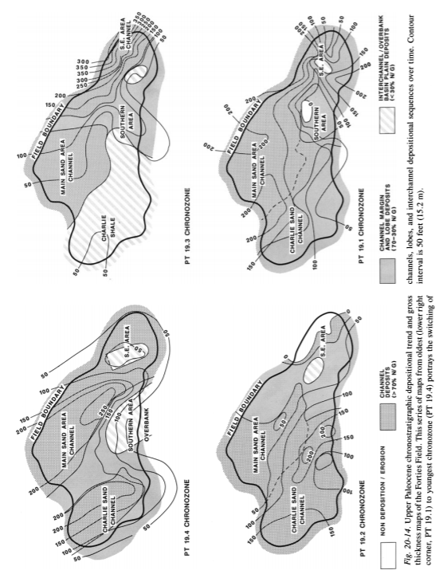
Depositional and Tectonic History
Upper Paleocene depositional history of Charlie Sand, Main Sand, & South Sand submarine fans
Oldest (lower right corner PT 19.1) to youngest (PT 19.4)
PT 19.4 zone
PT 19.3 zone
PT 19.2 zone
PT 19.1 zone
Notes:
The submarine fan environment of the Forties Field is complex, contains abrupt transitions from channels and lobes to interchannel facies of sandstone distribution in channel-fill and lobe sequence. There are three distinct fan-lobe sequences prograded south and southeastward during palynological time. From East to west, the fan-lobes are Charlie, Main, and S.E Forties Sands. These channel system acts as major sediment deposition and shifted continuously throughout the Forties Formation [5] as seen in figure 3 below.
SAY→ We are targeting the main sand channel area!!!

Slide 8
Depositional and Tectonic History
We are focusing on
Charlie Sand Channel and Main Sand Channel
PT 19.4 zone
Notes:
The submarine fan environment of the Forties Field is complex, contains abrupt transitions from channels and lobes to interchannel facies of sandstone distribution in channel-fill and lobe sequence. There are three distinct fan-lobe sequences prograded south and southeastward during palynological time. From East to west, the fan-lobes are Charlie, Main, and S.E Forties Sands. These channel system acts as major sediment deposition and shifted continuously throughout the Forties Formation [5] as seen in figure 3 below.
SAY→ We are targeting the main sand channel area!!!

Slide 9
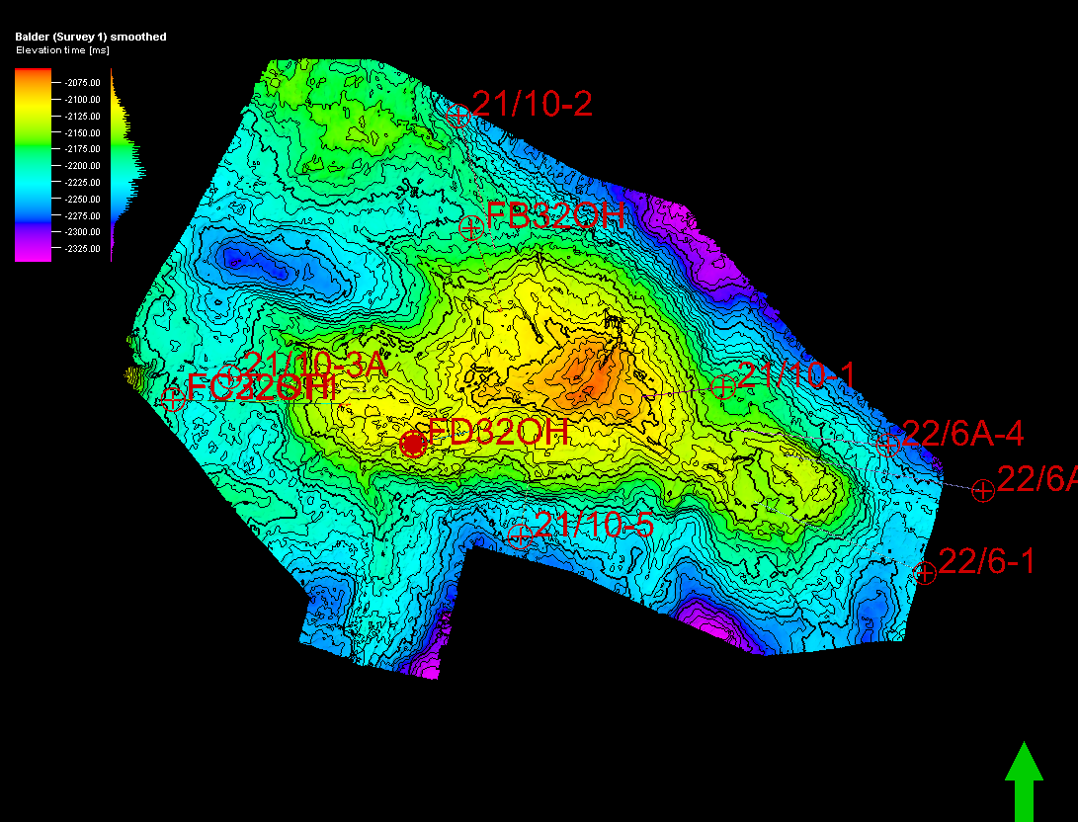
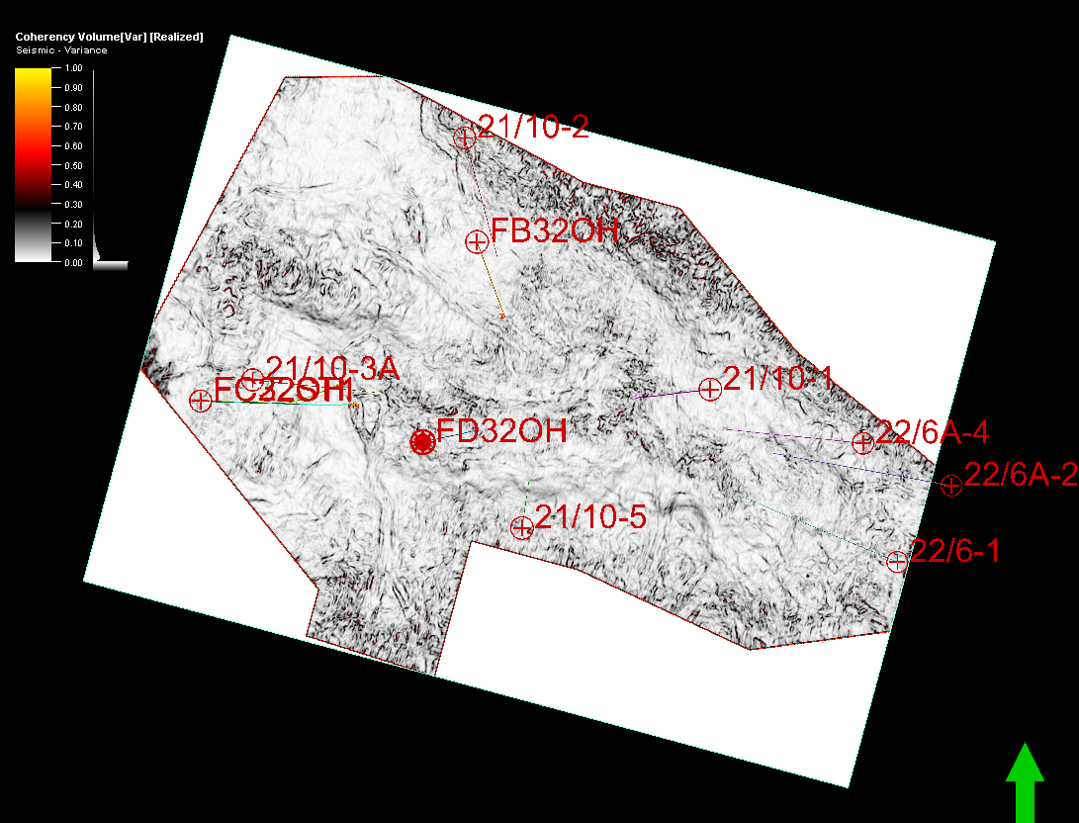
Charlie Sand Channel vs. Main Sand Channel
Forties Time-Structure Map
Forties Time Slice Coherency Map
Notes:
We are trying to compare the charlie and main sand
Explain the images. On the left you see the charlie and main have higher structure with anticlines. On the right shows coherency map shows both charlie and main
There are more wells on the Chari reservoir

Slide 10
Charlie Sand Channel vs. Main Sand Channel
Forties Time-Structure Map
Forties Time Slice Coherency Map
Main
Channel
Charlie
Channel
Notes:
We are trying to compare the charlie and main sand
Explain the images. On the left you see the charlie and main have higher structure with anticlines. On the right shows coherency map shows both charlie and main
There are more wells on the Chari reservoir

Slide 11
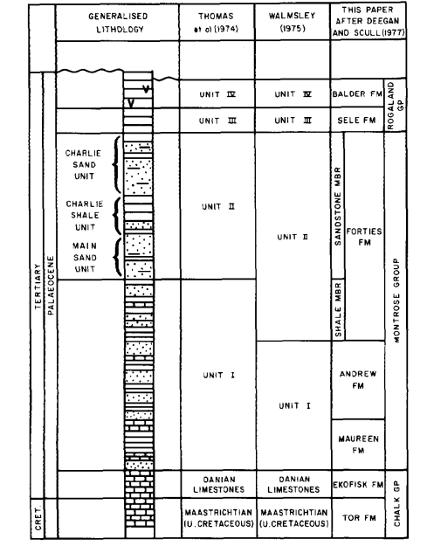
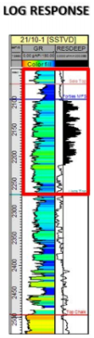
Depositional and Tectonic History
Forties Formation is divided into lower interbedded sandstone, shale, and limestone sequence
The Sandstone Member Unit (potential reservoir) contains the most Forties Oil contains:
Upper Charlie Sand
Lower Main Sand
Notes:
SAY: Early Paleogene lithostratigraphic nomenclature of Forties field (left) [3]
and typical log response of the Forties Sequence (right) [4].
The lithostratigraphy and structural settings subdivides the Paleocene/Eocene sandstones and shales of the field. The Forties Formation is divided into a lower interbedded sandstone, shale, and limestone sequence. Additionally, the Sandstone is further divided into two san units, the Main Sand unit and the Charlie Sand Unit, separated by the Charlie Shale unit. This Sandstone Member which contains the most of the Forties oil which represents the reservoir interval as seen in the figure 4 below.

Slide 12
Traps in Forties Field
Most traps are four-way closures produce from combined structural-stratigraphic traps where reservoirs are folded into domes or closed anticlines
Approximately 9% produce from purely stratigraphic traps
Types of Stratigraphic Traps
Channel trunctations
Lateral pinch-out
Channel bends and pinch-out
against topographic highs
Channel fills
Shale drapes
Notes:
The majority of the deep-water Forties field about 66% produces from a combined structural-stratigraphic traps and approximately 9% of them produce from purely stratigraphic traps
Based on the observation and analysis made in this study, a model including five types of
stratigraphic traps is proposed for both the North and South area (Fig. 4.1) (Fig. 4.2):
1. Channel Truncation
The interaction between the MTC (Element C) and the submarine incised complex
(Element A) interpreted in this section created regional sand to clay and could have
stratigraphic trapping potential. Hydrocarbons could be trapped within facies of lesser
reservoir quality such as channel margin, levee, overbank, and inter-channel deposits.
The MTC can act as an important laterally extensive seal.
2. Lateral pinch-out
It is interpreted that the channel system (Element A) extend laterally until they thin to
zero thickness at the edge of their basin of deposition. This system is surrounded by
basin muds, creating a good potential stratigraphic trapping.
3. Channel bends and pinch-out against topographic highs.
Pockets of hydrocarbons may be left behind at channels bends, pinch-outs against
topographic highs or behind faults. In these areas, sand-filled channels are in direct
contact with low permeability bodies. Moreover, the contact between the paleo-high
and the channels of this system is another area with good changes of having generated
stratigraphic pinch-outs (Fig 3.5).
4. Channel fill
These facies have the best reservoir characteristics and are relatively easy to produce.
Usually, this channel facies are characterized by a high net-gross compared with
surrounding depositional elements. This deposits are covered by laterally extensive
muds that act as seal.
5. Shale drapes
Stratigraphic traps are not common in amalgamated channel complexes where the
system is connected. However, channels may be lined by shale drapes that impede
flow across the channels. Fan channels also can be abandoned progressively, forming
thinning- and fining-upward sequences similar to those of fluvial or distributary
channels.

Slide 13
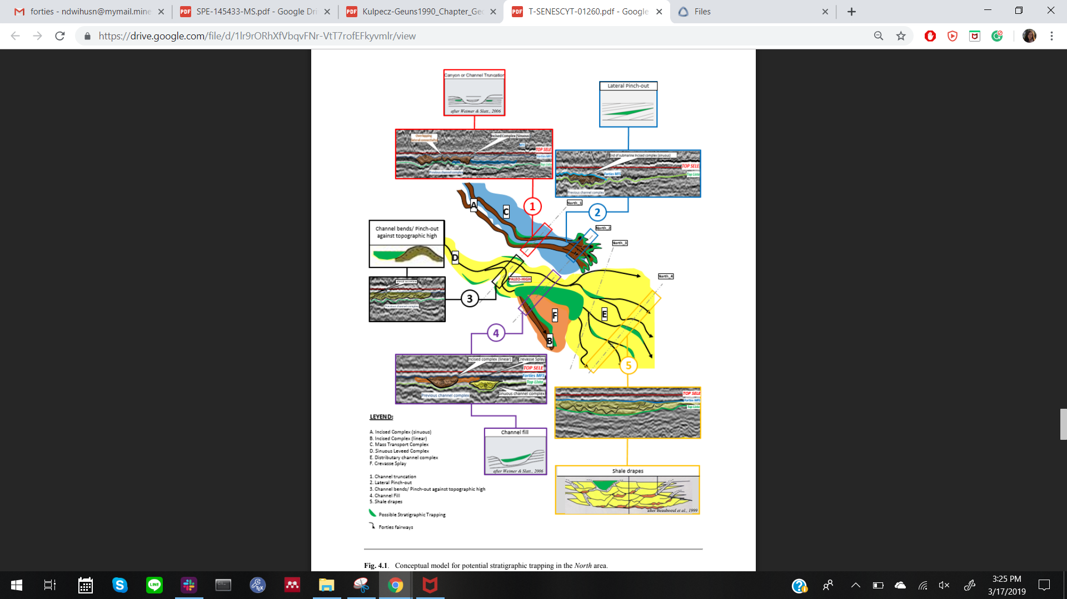
Stratigraphic Traps
Conceptual Model for potential stratigraphic trapping in North area
Types of Stratigraphic Traps
Channel trunctations
Lateral pinch-out
Channel bends and pinch-out
against topographic highs
Channel fills
Shale drapes

Slide 14
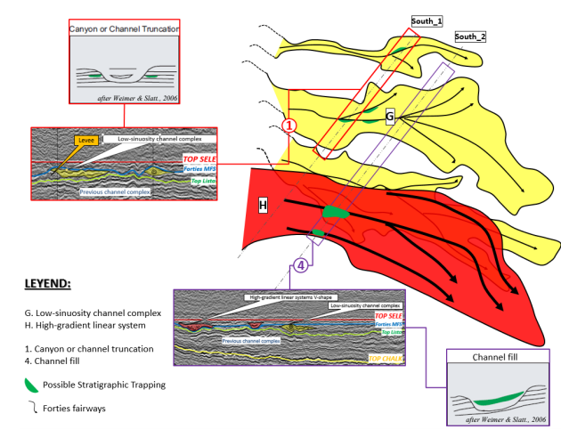
Stratigraphic Traps
Conceptual Model for potential stratigraphic trapping in South area
Types of Stratigraphic Traps
Channel trunctations
Lateral pinch-out
Channel bends and pinch-out
against topographic highs
Channel fills
Shale drapes
Notes:
Only 1 and 4!

Slide 15
Reservoir Characteristics
Source: Jurassic Kimmeridge Clay Formation
Time of Hydrocarbon Maturation: Early
Eocene to Pliocene
Time of Trap Formation: Eocene or later
Time of Migration: Neogene
Notes:
https://sp.lyellcollection.org/content/403/1/333/tab-figures-data

Slide 16
Reservoir Characteristics
Source: Jurassic Kimmeridge Clay Formation
Seal: Conformable Eocene Mudstone
Traps:
Anticlinal Structural Trap
(Four-way dip closure)
Syn-sedimentary faulting
Sedimentary drape
2 Main Forties Sandstone Reservoir:
Top Charlie Unit and Lower Main Unit
Notes:
https://sp.lyellcollection.org/content/403/1/333/tab-figures-data

Slide 17
Exploration Workflow
Geological
Framework
Volume
Attribute Maps
Prospect
Elements
Prospect Assessment
Tectonic History
Structural Interpretation
- Faults and folds
- Uplifts
- Structural trends/features
Stratigraphic Interpretation
- Unconformities
- Packages
- Facies, lithologies, ages
Present Day Conditions
Analyze Key Packages
- Potential Reservoirs
- Source Rocks
Source
Reservoir
Migration
Trap
Chance of Success
- Trap size
- Hydrocarbon Content
- Compartments
- Recovery factor
Notes:
Develop geologic framework
Major faults, unconformities and stratigraphic packages (depositional sequences)
Structural interpretations
Faults folds
Uplifts
Structural trends and features
Stratigraphic interpretation
Unconformities
Packages
Facies, lithologies, ages
Basin reconstruction - how things evolved
Data analysis
Analyze all the key packages -- where are potential reservoirs, source rocks, etc
Present day conditions - how things are now
Prospect elements (Source, Migration, Reservoir, Trap)
Identify prospects -- where all the HC system elements look favorable
Where we are willing to propose a drill site to management
Prospect assessments
What type of volume of HC do we expect?
What is the chance of success or risk?

Slide 18
Compare Two SS Units
The Sandstone Member Unit
Top Charlie Sand
Lower Main Sand
Notes:
SAY: Early Paleogene lithostratigraphic nomenclature of Forties field (left) [3]
and typical log response of the Forties Sequence (right) [4].
The lithostratigraphy and structural settings subdivides the Paleocene/Eocene sandstones and shales of the field. The Forties Formation is divided into a lower interbedded sandstone, shale, and limestone sequence. Additionally, the Sandstone is further divided into two san units, the Main Sand unit and the Charlie Sand Unit, separated by the Charlie Shale unit. This Sandstone Member which contains the most of the Forties oil which represents the reservoir interval as seen in the figure 4 below.

Slide 19
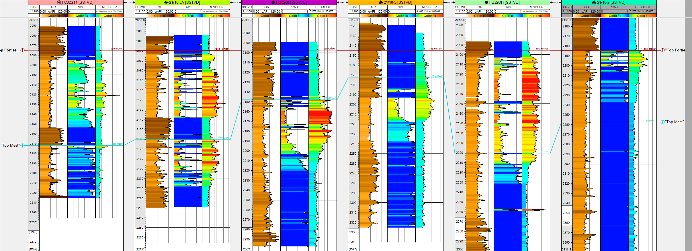
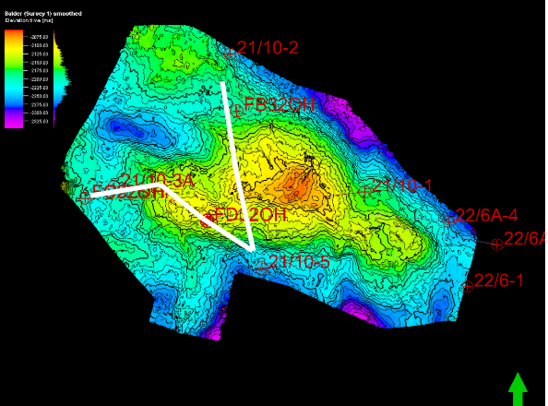
Well Correlation NE to SW

Slide 20
Well Correlation NE to SW: Upper Forties Charlie Unit

Slide 21
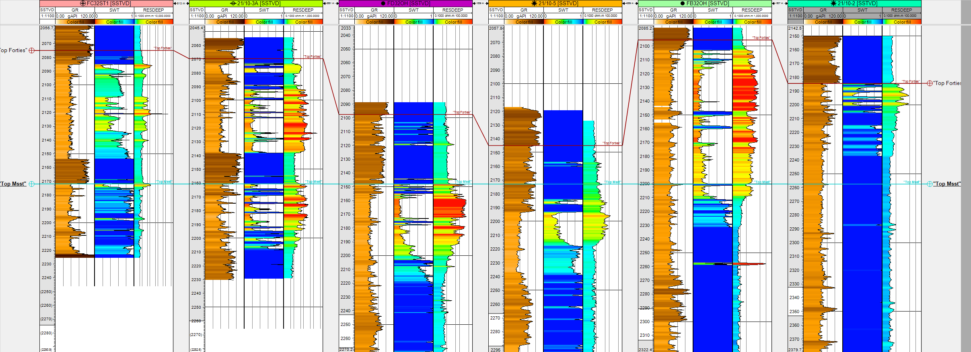
Well Correlation NE to SW: Lower Forties Main Unit
Correlation NE to SW - Top Forties

Slide 22
Reservoir Characteristics
Main Reservoir - Top Forties Charlie Sand
• Age: Upper Paleocene
• Stratigraphic Unit: Forties Formation
• Lithology: Litharenites
• Depositional Environment: Submarine fan
• Productive Facies: Channel-fill, lobe, and
interchannel sandstone
Notes:
https://sp.lyellcollection.org/content/403/1/333/tab-figures-data

Slide 23
Reservoir Quality Prediction
Main Reservoir - Top Forties Charlie Sand
Reservoir Rock
• Porosity (%): 25 - 27
• Permeability (mD): 200 - 2000
• Sw: Average 23 % range 22 - 32 %
• Formation Volume Factor: 1.029
• Recovery Factor (%): 57
Notes:
Reservoir quality prediction (rock and fluids) through attribute analysis and well correlations through cross plots (example: porosity vs. P-impedance, etc)

Slide 24
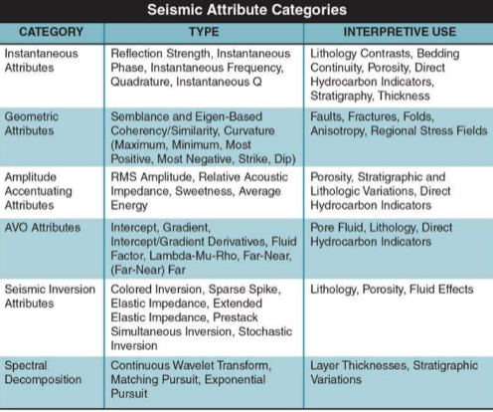
Volume Attributes

Slide 25
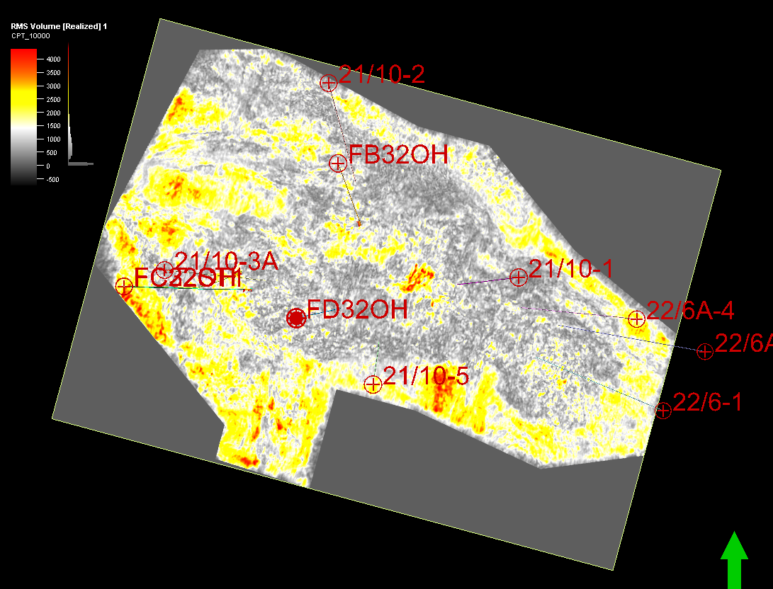
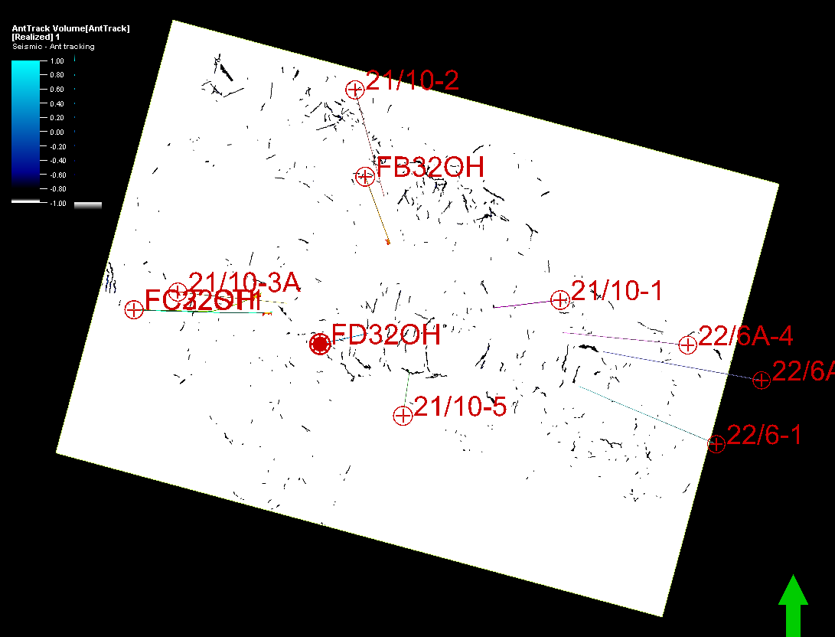
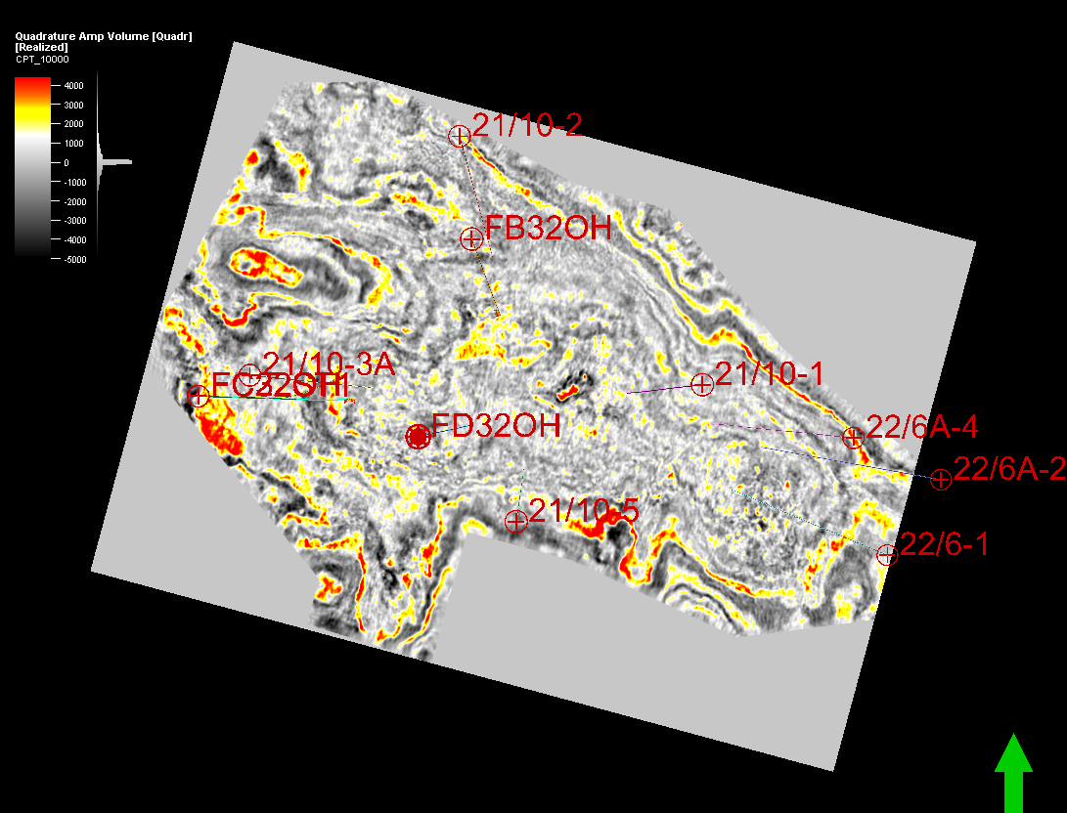
3D Volume Attributes
Coherency RMS Amplitude
Ant Tracking Quadrature

Slide 26
3D Volume Attributes
Coherency RMS Amplitude
Ant Tracking Quadrature

Slide 27
Exploration Workflow
Geological
Framework
Volume
Attribute Maps
Prospect
Elements
Prospect Assessment
Tectonic History
Structural Interpretation
- Faults and folds
- Uplifts
- Structural trends/features
Stratigraphic Interpretation
- Unconformities
- Packages
- Facies, lithologies, ages
Present Day Conditions
Analyze Key Packages
- Potential Reservoirs
- Source Rocks
Source
Reservoir
Migration
Trap
Chance of Success
- Trap size
- Hydrocarbon Content
- Compartments
- Recovery factor
Notes:
Develop geologic framework
Major faults, unconformities and stratigraphic packages (depositional sequences)
Structural interpretations
Faults folds
Uplifts
Structural trends and features
Stratigraphic interpretation
Unconformities
Packages
Facies, lithologies, ages
Basin reconstruction - how things evolved
Data analysis
Analyze all the key packages -- where are potential reservoirs, source rocks, etc
Present day conditions - how things are now
Prospect elements (Source, Migration, Reservoir, Trap)
Identify prospects -- where all the HC system elements look favorable
Where we are willing to propose a drill site to management
Prospect assessments
What type of volume of HC do we expect?
What is the chance of success or risk?

Slide 28
Reservoir - Upper Forties Charlie Sand

Slide 29
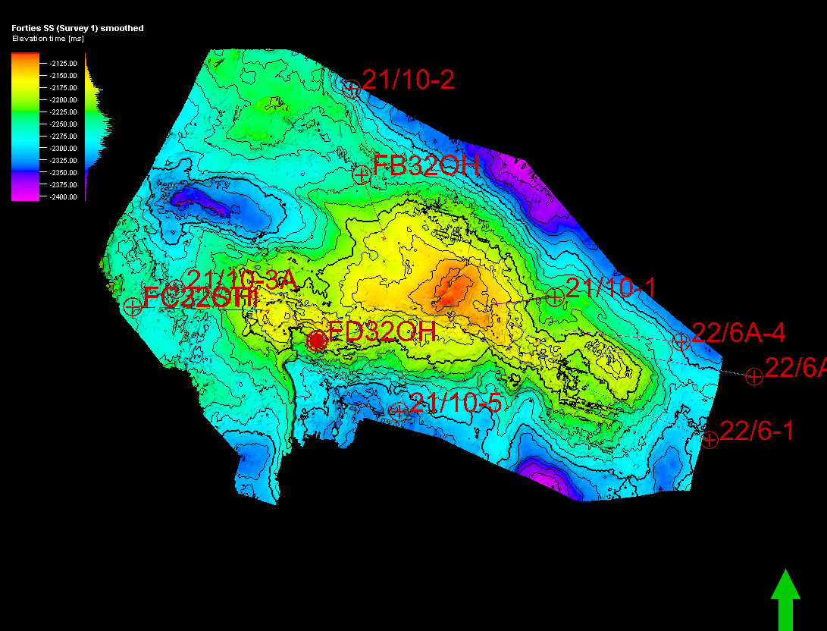
Reservoir (Charlie Sand) - Time Structure Map

Slide 30
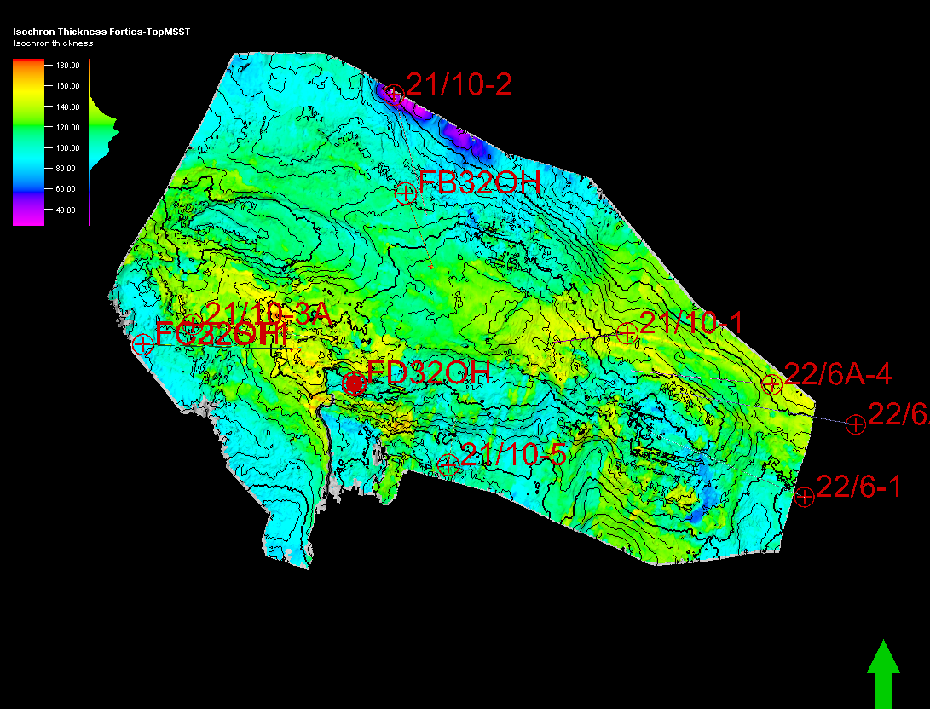
Reservoir (Charlie Sand) - Isochron Map

Slide 31
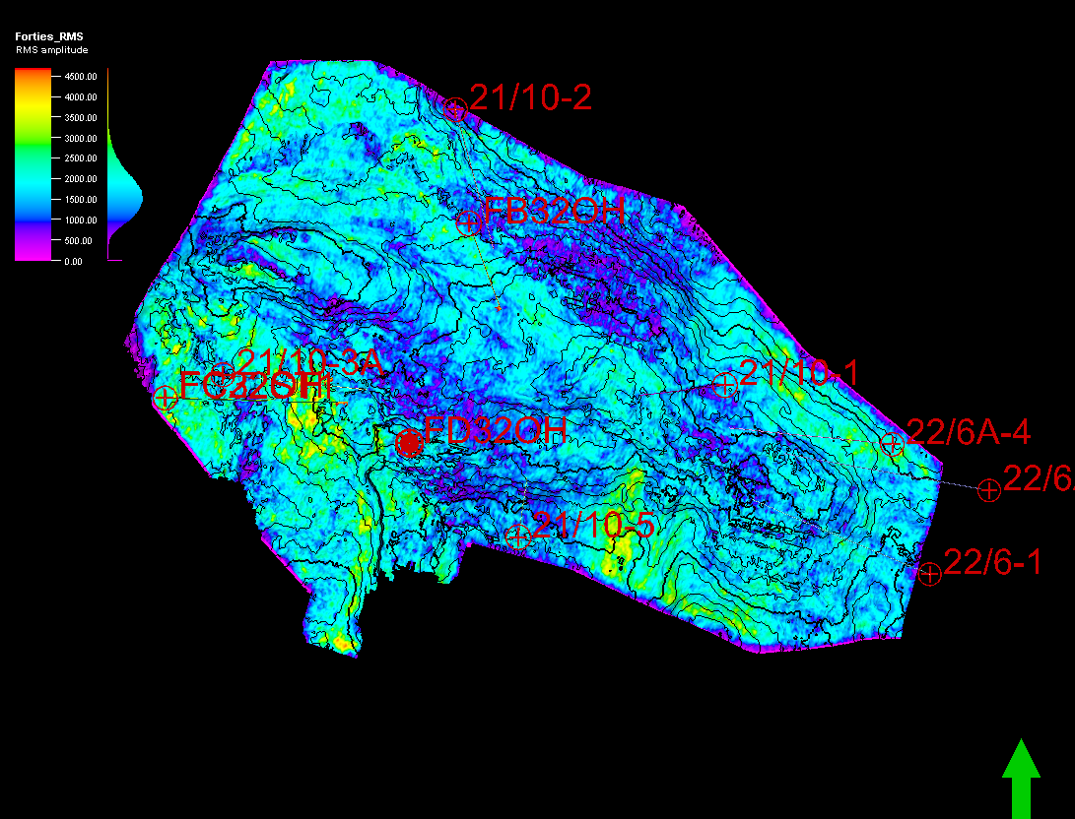
Reservoir (Charlie Sand) - RMS Amplitude

Slide 32
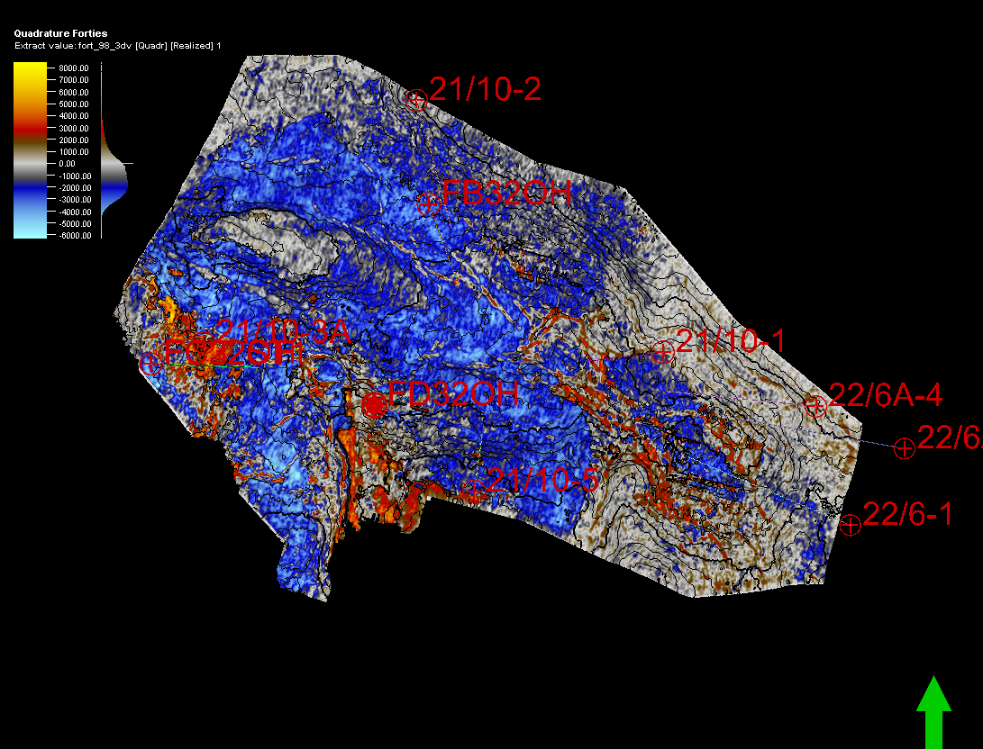
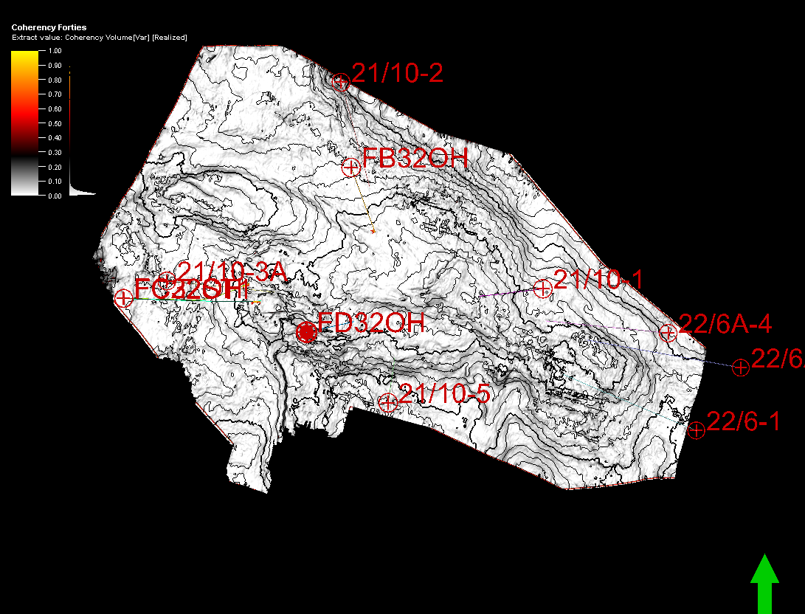
Reservoir (Charlie Sand)
Isochron Time-Structure
1. RMS Amplitude 2. Quadrature 3. Coherency

Slide 33
Reservoir (Charlie Sand)
Isochron Time-Structure
1. RMS Amplitude 2. Quadrature 3. Coherency

Slide 34
Seal - Balder

Slide 35
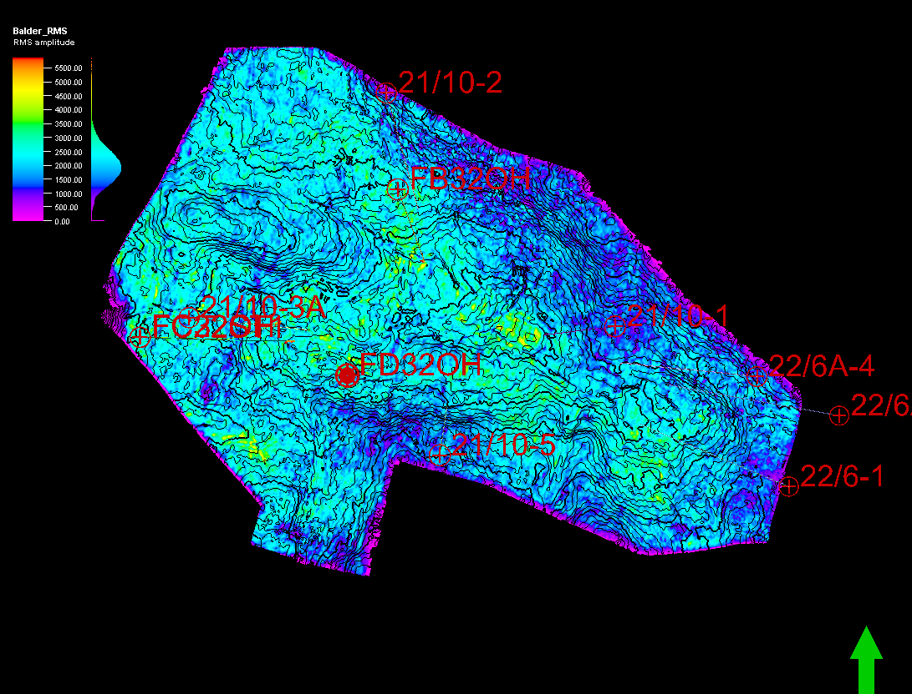
Seal (Balder) - RMS Amplitude

Slide 36
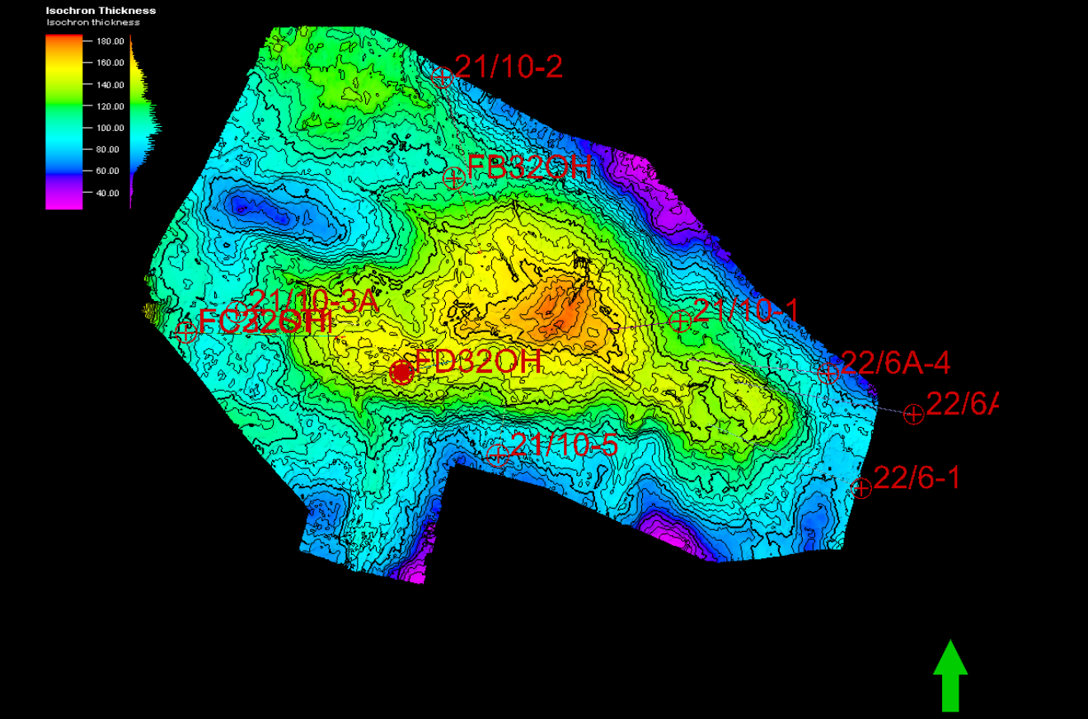
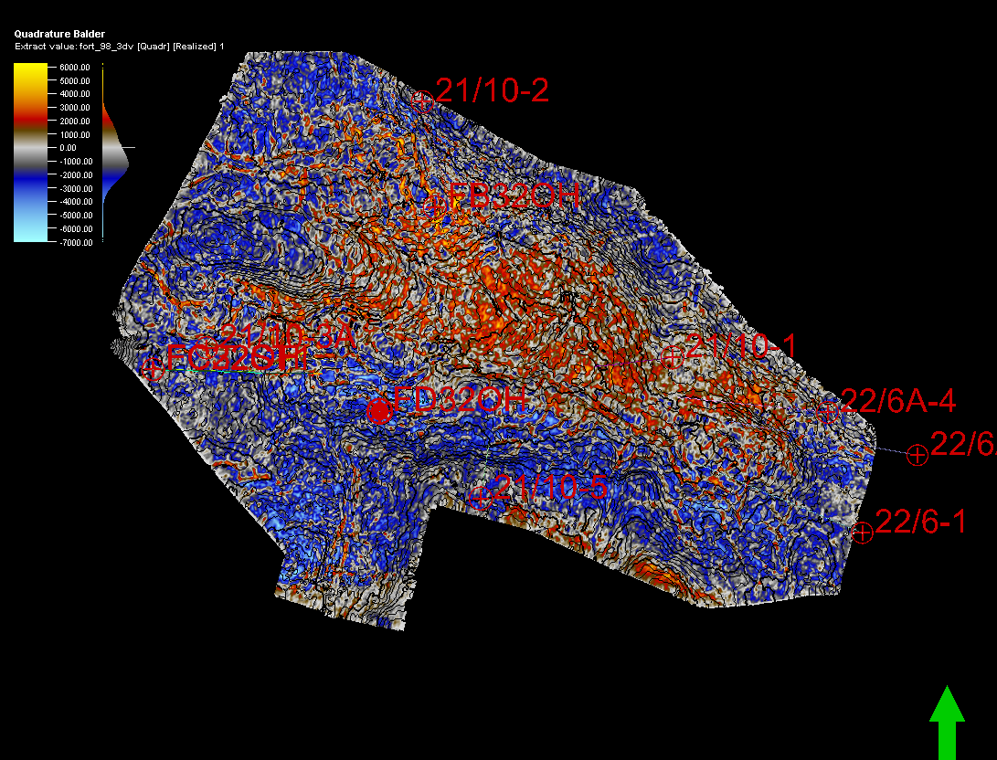
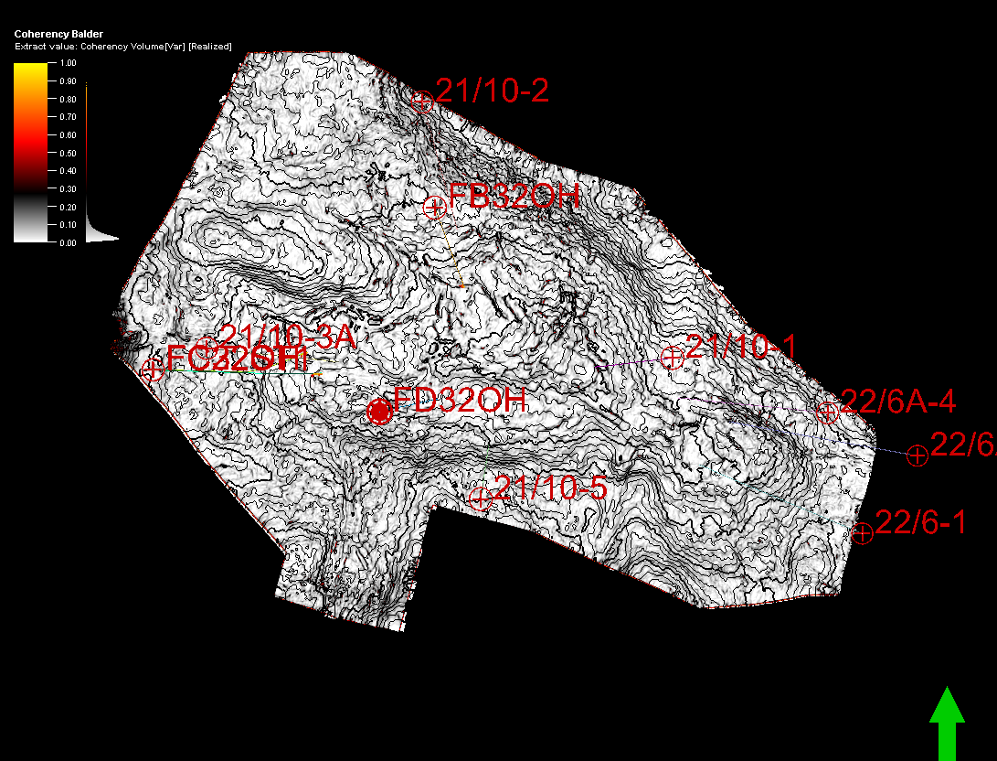
Seal (Balder)
Time Structure 1. RMS Amplitude
2. Quadrature 3. Coherency

Slide 37
Seal (Balder)
Time Structure 1. RMS Amplitude
2. Quadrature 3. Coherency

Slide 38
Potential Reservoir Area

Slide 39
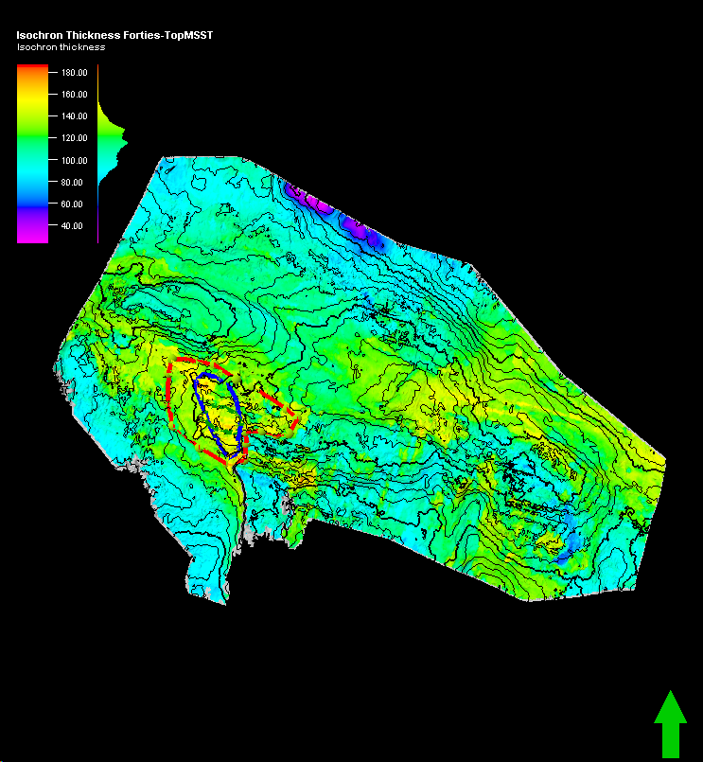
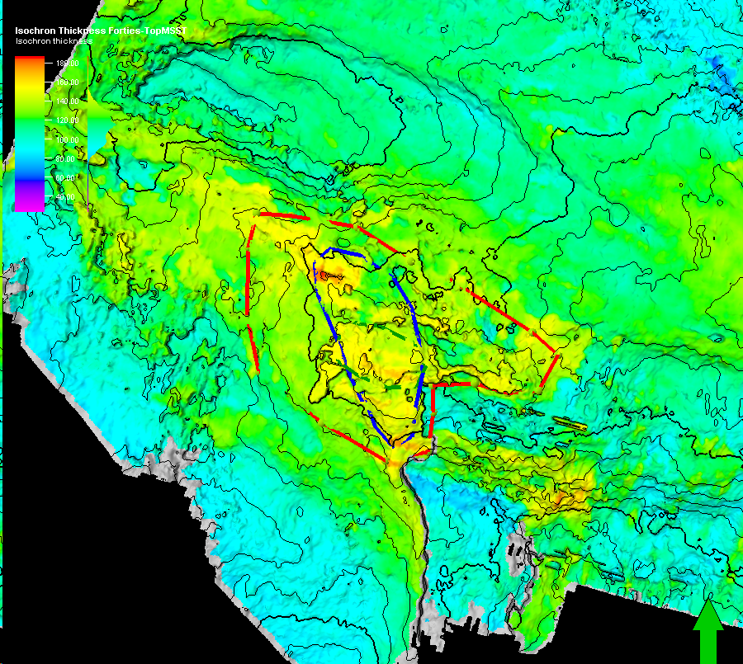
Potential Area - Upper Forties Charlie Sand Isochron

Slide 40
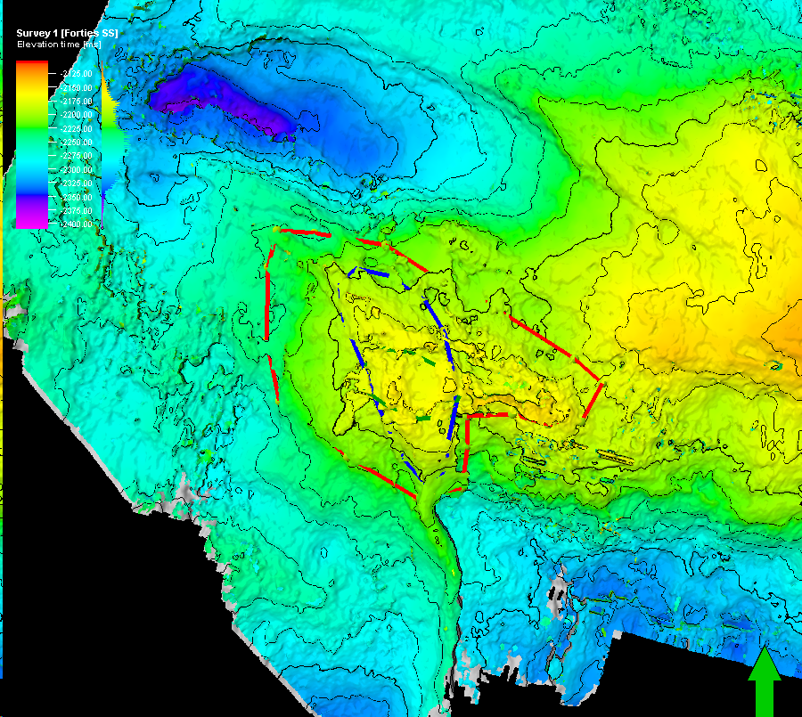
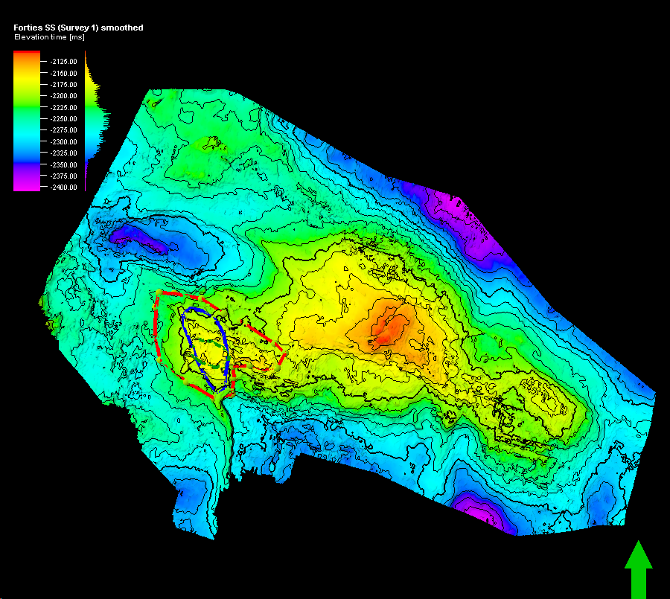
Potential Area - Upper Forties Charlie Sand Structure

Slide 41
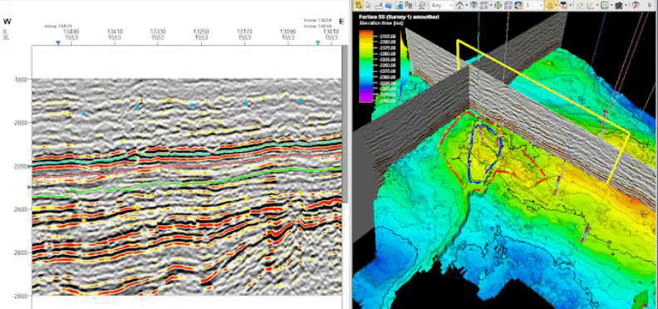
Potential Area - Upper Forties Charlie Sand Xline

Slide 42
Potential Area - Upper Forties Charlie Sand Inline

Slide 43
Drilling Location - Upper Forties Charlie Sand Isochron

Slide 44
Exploration Workflow
Geological
Framework
Volume
Attribute Maps
Prospect
Elements
Prospect Assessment
Tectonic History
Structural Interpretation
- Faults and folds
- Uplifts
- Structural trends/features
Stratigraphic Interpretation
- Unconformities
- Packages
- Facies, lithologies, ages
Present Day Conditions
Analyze Key Packages
- Potential Reservoirs
- Source Rocks
Source
Reservoir
Migration
Trap
Chance of Success
- Trap size
- Hydrocarbon Content
- Compartments
- Recovery factor
Notes:
Develop geologic framework
Major faults, unconformities and stratigraphic packages (depositional sequences)
Structural interpretations
Faults folds
Uplifts
Structural trends and features
Stratigraphic interpretation
Unconformities
Packages
Facies, lithologies, ages
Basin reconstruction - how things evolved
Data analysis
Analyze all the key packages -- where are potential reservoirs, source rocks, etc
Present day conditions - how things are now
Prospect elements (Source, Migration, Reservoir, Trap)
Identify prospects -- where all the HC system elements look favorable
Where we are willing to propose a drill site to management
Prospect assessments
What type of volume of HC do we expect?
What is the chance of success or risk?

Slide 45
Reservoir Calculation
Main Reservoir - Top Forties Charlie Sand
• Porosity (%): 25 - 27
• Permeability (mD): 200 - 2000
• Sw: Average 23 % range 22 - 32 %
• Formation Volume Factor: 1.029
• Recovery Factor (%): 57
Notes:
Reservoir quality prediction (rock and fluids) through attribute analysis and well correlations through cross plots (example: porosity vs. P-impedance, etc)

Slide 46
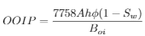
Revenue Calculation
Revenue = OOIP * RF x Price
Voil: 30 MMbbl (w/ EOR) 18MMbbl (w/out EOR)
Price = $60.27 USD (WTI); $67.61 USD (BRENT)
Revenue: $1.8B USD (w/ EOR) $1.0B (w/out EOR)
Thickness: 205 ft (Top: 6955 ft; Base: 7160 ft )
Net/Gross: Average 0.70, range 0.25 - 1.0

Slide 47
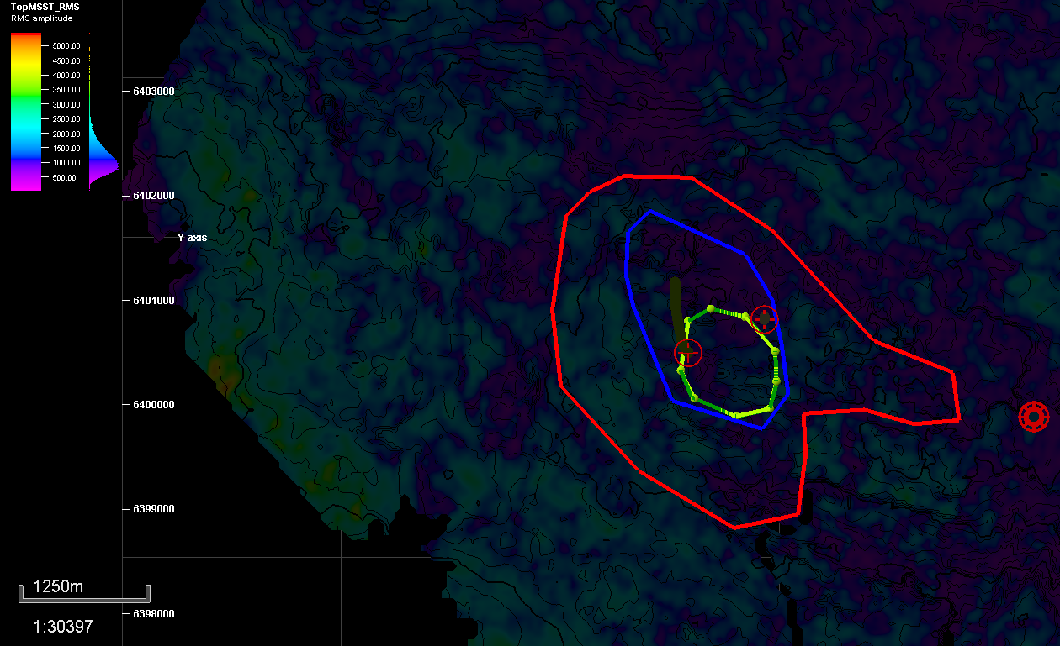
Reservoir Parameters
Area:
P10 : 740 acres
P50: 530 acres
P90: 175 acres
Thickness:
205 ft (Top: 6955 ft; Base: 7160ft)

Slide 48
Conclusion
Geological Framework
Volume Attribute Maps
Prospect Elements
Prospect Assessment
Recommendation Moving Forward
Case | OOIP (EOR) | OOIP | Revenue (EOR) | Revenue
P90 | 28MMbbl | 17MMbbl | $1.7B | $1B
P50 | 85MMbbl | 50MMbbl | $5B | $3B
P10 | 120MMbbl | 70MMbbl | $7B | $4B
Notes:
Developing Field
Plans on how to develop the field or area and economic modelling - P10, P50,P50 (low, mid, high, case)
Geological and Petroleum Engineering Evaluation and Assessment
Moving forward...

Slide 49
References
[1] GPGN 558: Seismic Interpretation Lecture Notes
[2] “Overview of Seismic Interpretation.” Robbie Gries: A Career of Many 'Firsts' -
AAPG Explorer April 2012,archives.aapg.org/slide_resources/schroeder/9/index.cfm.
[3] P.J. Hill, “Geology of the Forties Field, U.K. Continental Shelf, North Sea.”
[4] Jose Rodas, “Investigating Stratigraphic Trapping Potential in the Forties Formation,
Palaeocene, UK Central Graben.”
[5] Alexander Kulpecz, “Geological Modeling of a Turbidite Reservoir, Forties Field, North Sea.”

Slide 50
Appendix

Slide 51
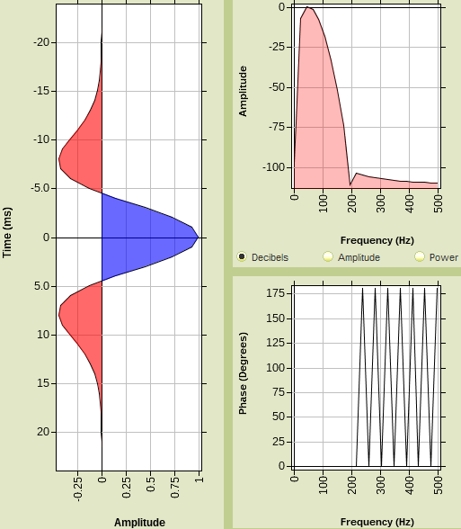
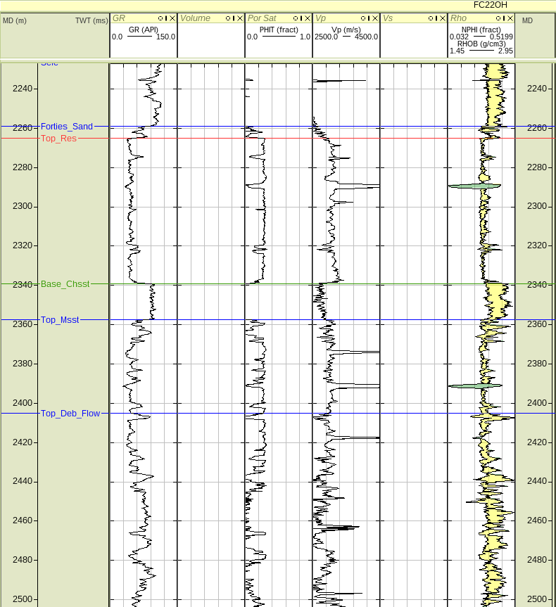
Wedge Model Using Up-Scaled Well Logs

Slide 52
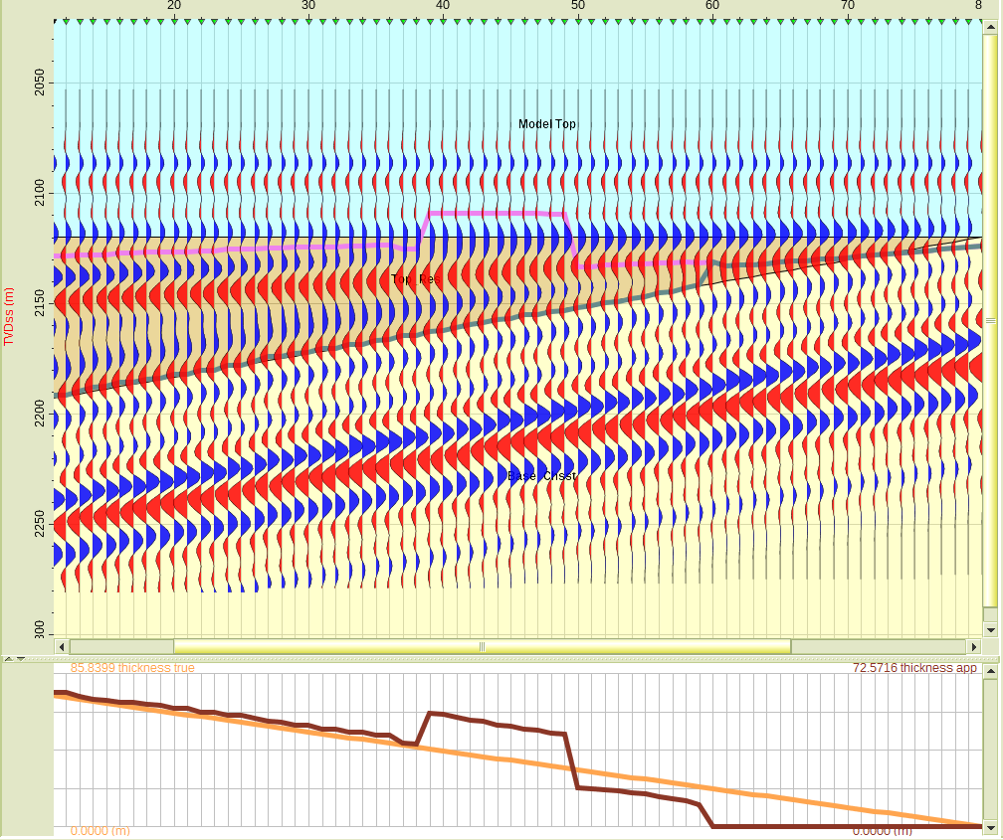
Wedge Model Using Up-Scaled Well Logs

Slide 53
Bottom of Reservoir - Top of Charlie Shale

Slide 54
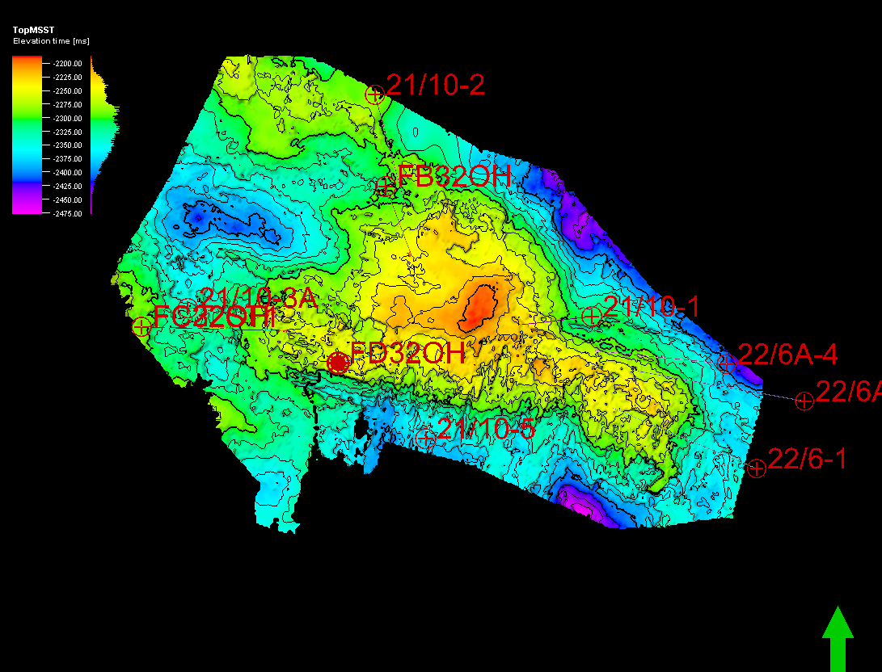
Reservoir Bottom - Time Structure Map

Slide 55
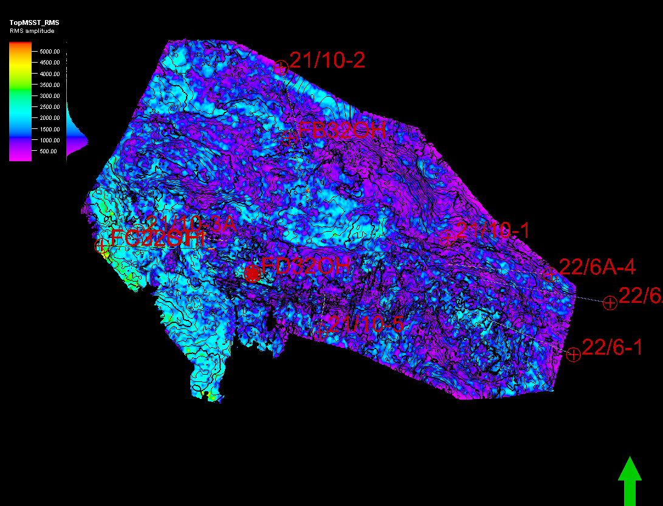
Reservoir Bottom - 1. RMS Amplitude

Slide 56
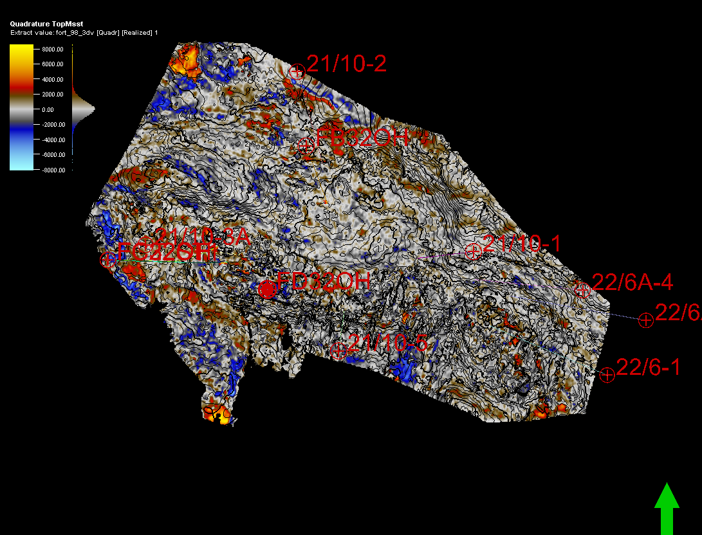
Reservoir Bottom - 2. Quadrature

Slide 57
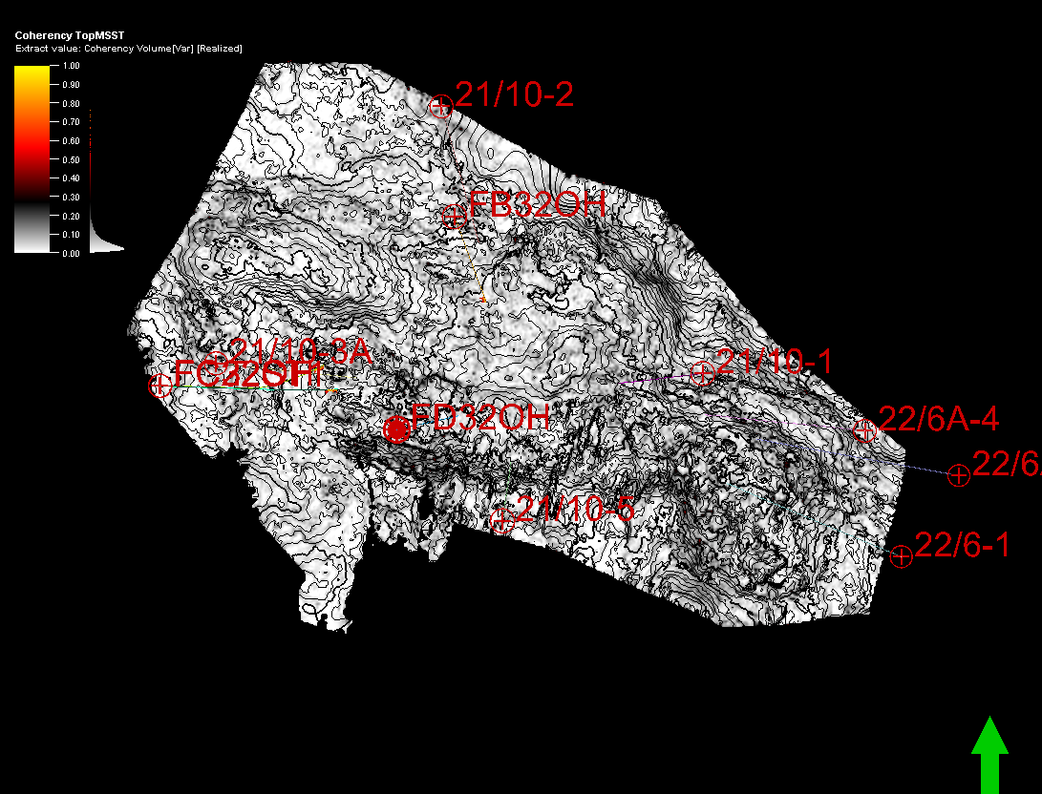
Reservoir Bottom - 3. Coherency

Slide 58
Reservoir Bottom
Time Structure 1. RMS Amplitude
2. Quadrature 3. Coherency

